Slide 1
Development of Novel Algorithms
By Team: Quantum Cats
Mahroo
Cynthia Cruz Sanchez, (do we put what we studied? No)
Johanna
Womanium Summer 2024, Projet Component
Notes:
As computers and quantum computing hardware advances, the number and quality of qubit, one of the key challenges of the quantum ecosystem
is the development of efficient and novel quantum algorithms that are useful and offer exponential advantage over classical methods.

Slide 2
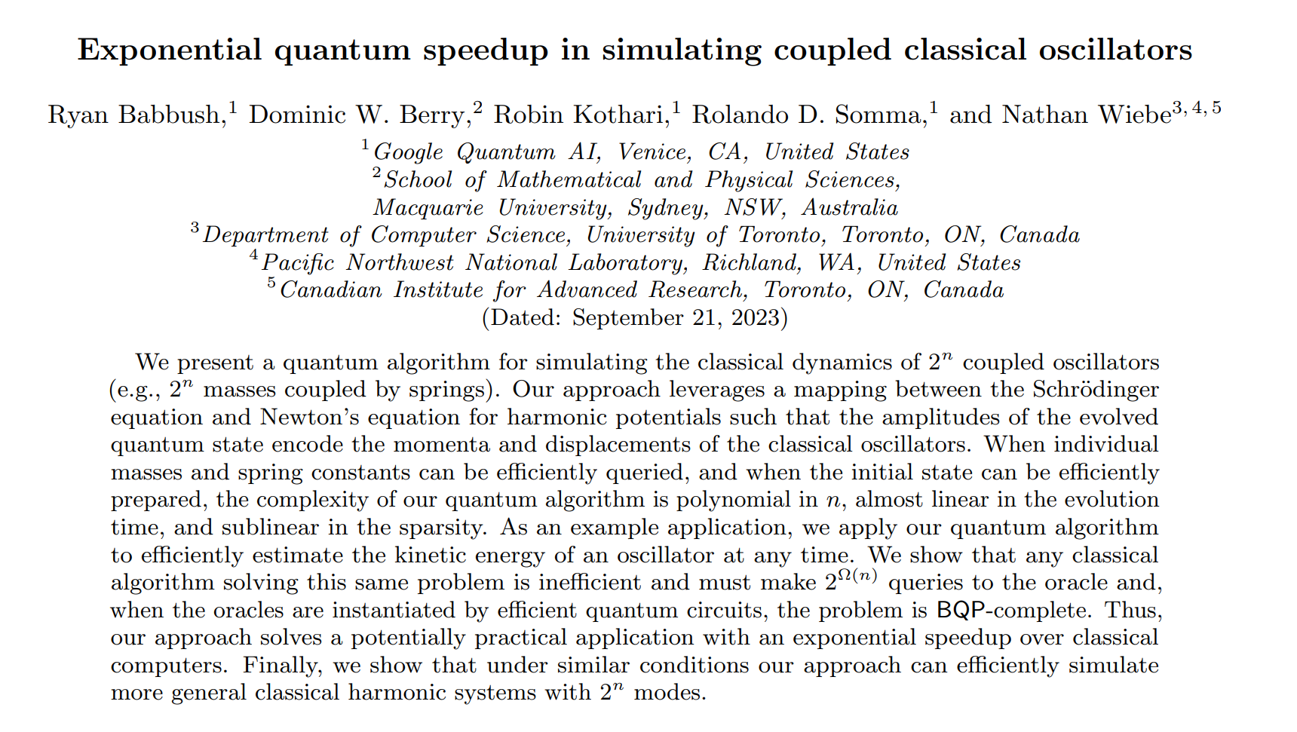
Selected paper:
arXiv:2303.13012v3 [quant-ph]
Notes:
This paper presents results of an approach solves a potentially practical application of simulating coupled classical oscillators with exponential speedup over classical computers. It further aldo demonstrate that under similar conditions such approach can also efficiently simulate more general classical harmonic systems with 2n nodes.

Slide 3
Key Details for Final Project Presentation:
All teams must submit a final project presentation deck by linking it on their Github project repos by Aug.9.
You may optionally also attach a recording of your presentation on your GitHub repo.
The maximum duration of the presentation is 3 minutes.
Project finalists will be invited to present their presentations on the Demo Day [Aug.15].
Recommended format for Final Project Presentation:
The following should be covered in your presentation:
Problem Statement - what is your project about? What problem are you trying to solve? [~30 seconds]
Your project solution - what were the different objectives of your project and how did you achieve them? [~60-90 seconds]
Success - Did you achieve your desired results? What were your success metrics? How did your project make an impact on the current field of Quantum Science? [~30-60 seconds]
Future scope - What are some future steps you would recommend to extend your project? What limitations are you facing today stopping you from achieving your future recommendations? [~30 seconds]
The Womanium Logo [link] should be clearly visible on your presentation.
Each presentation slide must display/ mention “Womanium Quantum+AI Project”.
You are NOT allowed to use any third-party images/ logos without proper references in your presentation.

Slide 7
1) Participants need to implement, optimize, one of the following quantum
algorithms using Classiq:
a) Classically verifiable quantum advantage from a computational Bell
Test.
b) Exponential quantum speedup in simulating coupled classical
oscillators.
c) Evidence for the utility of quantum computing before fault tolerance.

Slide 8
4. Project Tasks/ Deliverables:
2) The first step will be to implement a toy problem of the chosen algorithm.
This should be a simple implementation (the simplest possible) that covers
the:
a) Encoding of the problem.
b) The key algorithmic building blocks of the chosen paper (e.g.
Hamiltonian simulation).
c) The readout and post-processing.
The implementation should be scalable, such that it is clear how to extend it
for a more complicated scenario, and it should be checked and tested using
a simulator.
3) The second step is to enlarge the problem for a more complicated scenario.
In this step, the actual problems from the papers should be implemented
(e.g. the actual Hamiltonian that is shown in the paper should be
implemented). Resources estimation in terms of circuit depth, circuit width
and number of 2-qubit gates should be made and compared across several
hardwares.
4) The last step would be to optimize the solution for the most adequate
hardware that was found in the second step.

Slide 9
Deliverables:
● Slides that summarize the work.
● The .qmod and .qprog files for each step.
● The Python Jupyter notebooks of each step (if applicable).

